Slide 1
Binary Heaps
What if we’re mostly concerned with finding the most relevant data?
A binary heap is a binary tree (2 or fewer subtrees for each node)
A heap is structured so that the node with the most relevant data is the root node, the next most relevant as the children of the root, etc.
A heap is not a binary search tree
A heap does not order its node
A heap is a complete tree.
Every level but the leaf level is full
Binary Heap – another way to implement a priority queue!

Slide 2
Definition of a Binary Heap
A tree is a binary heap if
It is a complete tree
Every level is full except the bottom level
The value in the root is the largest of the tree
Or smallest, if the smallest value is the most relevant and that is how you choose to structure your tree
Every subtree is also a binary heap
Equivalently, a complete tree is a binary heap if
Node value > child value, for each child of the node
Note: This use of the word “heap” is entirely different from the heap that is the allocation area in C++

Slide 3
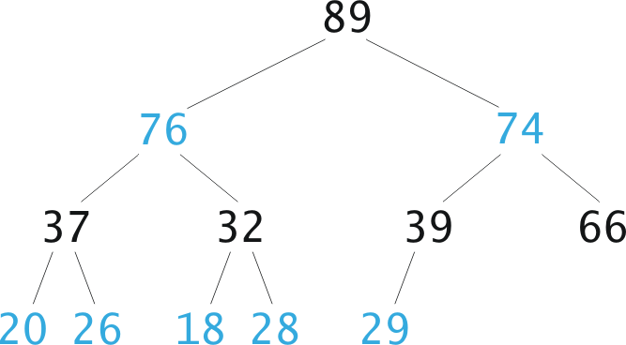
Is this a Binary Heap?

Slide 4
Inserting an Item into a Binary Heap
Insert the item in the next position across the bottom of the complete tree:
preserves completeness
Restore “heap-ness”:
while new item is not root and is greater than its parent
swap new item with its parent

Slide 5
Insert 80?
80
74
80
6
66
80
How many steps? At most, how many steps to insert?

Slide 6
Removing an Item
We always remove the top (root) node!
The point of a heap is to find the largest (or smallest) value in a set of numbers
and that number is at the root!
Remove the root
Leaves a “hole”:
Fill the “hole” with the last item (lower right-hand leaf) L
Preserve completeness
Swap L with largest child, as necessary
Restore “heap-ness”

Slide 7
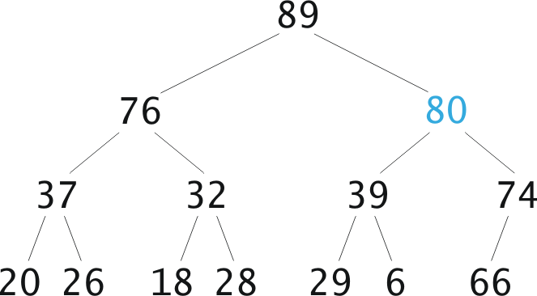
Remove?
89
80
66
66
74
66
How many steps? At most, how many steps to remove?
Next: how would we implement a heap?

Slide 8
Implementing a Heap
Yeah, yeah, we could use nodes and pointers, but…
Recall: a heap is a complete binary tree
If we know the number of nodes ahead of time, a complete binary tree fits nicely in an array:
The root is at index 0
Children of 0 are at 1 and 2
Children of 1 are at 3 and 4
Children of 2 are at 5 and 6
Children of 3 are at 7 and 8
Children of 4 are at 9 and 10
Is there a formula for figuring out where children of a node are? Parents?
Where would we insert the next node (the child of the node containing 7)?
11
0
0
1
2
3
4
5
6
7
8
8
1
3
7
2
11
8
7
2
5
4
2
3
5
5
4
4
5

Slide 9
Inserting into a Heap
Insert new item at end; set child to curr_size-1
Set parent to (child – 1)/2
while (parent ≥ 0 and arr[parent] < arr[child])
Swap arr[parent] and arr[child]
Set child equal to parent // so child is now (child – 1)/2
Set parent to (child – 1) / 2
How do we delete?

Slide 10
Deleting from a Heap
Set arr[0] to arr[curr_size-1], and shrink curr_size by 1
Set parent to 0
flag = true
while (flag)
Set leftchild to 2 * parent + 1, and rightchild to leftchild + 1
if leftchild ≥ curr_size,
flag is false
else:
Set maxchild to leftchild
If rightchild < curr_size and arr[rightchild] > arr[leftchild]
set maxchild to rightchild
If arr[parent] ≥ arr[maxchild],
Flag is false
else:
Swap arr[parent] and arr[maxchild];
set parent to maxchild

Slide 11
Performance of Heap
A complete tree of height h has:
Less than 2^{h} nodes (why?)
At least 2^{h-1} nodes
Thus complete tree of n nodes has height O(log n)
Insertion and deletion at most are O(log n), always
Heap is useful for priority queues

Slide 12
Which of the following is (are) a heap?
0 | 1 | 2 | 3 | 4 | 5 | 6 | 7 | 8 | 9
42 | 21 | 58 | 12 | 31 | 48 | 64 | 6 | 14 | 29
A
0 | 1 | 2 | 3 | 4 | 5 | 6 | 7 | 8 | 9
42 | 41 | 35 | 39 | 37 | 24 | 12 | 38 | 8 | 36
B
C
0 | 1 | 2 | 3 | 4 | 5 | 6 | 7 | 8 | 9
thunder | storm | mud | squirrels | grass | flowers | dandelions | petunias | spring | baby birds

Slide 13
Try:
0 | 1 | 2 | 3 | 4 | 5 | 6 | 7 | 8 | 9 | 10 | 11 | 12 | 13 | 14
58 | 45 | 56 | 20 | 33 | 12 | 50 | 18 | 19 | 24 | 7 | 2 | 6 | 41
18’s parent is?
(7-1)/2, or 20 (at location 3)
Perform a delete
Remove 58
41 goes to position 0
Bubble 41 down
0 | 1 | 2 | 3 | 4 | 5 | 6 | 7 | 8 | 9 | 10 | 11 | 12 | 13 | 14
41 | 45 | 56 | 20 | 33 | 12 | 50 | 18 | 19 | 24 | 7 | 2 | 6
0 | 1 | 2 | 3 | 4 | 5 | 6 | 7 | 8 | 9 | 10 | 11 | 12 | 13 | 14
56 | 45 | 41 | 20 | 33 | 12 | 50 | 18 | 19 | 24 | 7 | 2 | 6
0 | 1 | 2 | 3 | 4 | 5 | 6 | 7 | 8 | 9 | 10 | 11 | 12 | 13 | 14
56 | 45 | 50 | 20 | 33 | 12 | 41 | 18 | 19 | 24 | 7 | 2 | 6

Slide 15
Heapsort
Heapsort
Works in place: no additional storage
Idea:
Insert each element into a priority queue
Repeatedly remove from priority queue to array
Array slots go from 0 to n-1

Slide 16
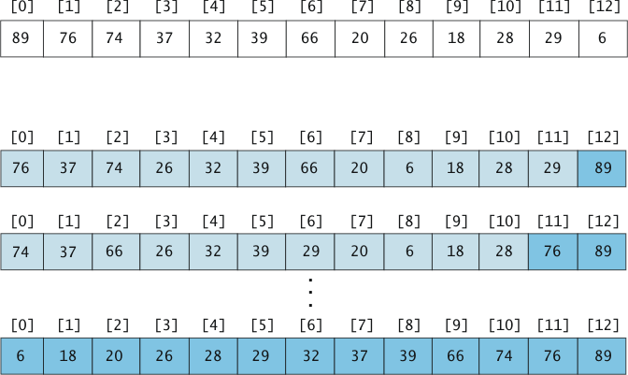
Heapsort Picture

Slide 17
Algorithm for In-Place Heapsort
Build heap starting from unsorted array
While the heap is not empty
Remove the first item from the heap:
Swap it with the last item
Restore the heap property

Slide 18
Heapsort Analysis
Insertion cost is log n for heap of size n
This is O(n log n)
Removal cost is also log n for heap of size n
Total removal cost = O(n log n)
Total cost is O(n log n)

Slide 19
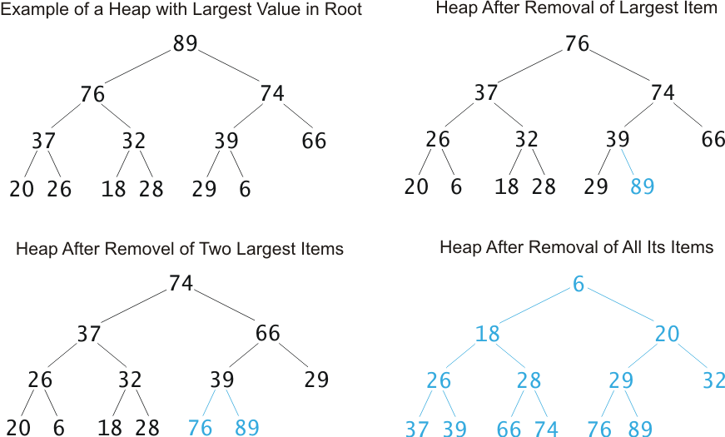
Heapsort Picture

Slide 20
Example: Selection problem (Kth largest)
If we had a set of unordered numbers, how would we determine the kth largest (or smallest, by reversing the process)?
E.g.,
11, 7, 1, 3, 8, 4, 9, 2, 6, 10, 5
What if we wanted the 5th largest element? How would we do this? How long would it take?

Slide 21
Can we do better?
Of course.
11, 7, 1, 3, 8, 4, 9, 2, 6, 10, 5
(for this, pretend as if we’re looking for the kth smallest element)
1. build a heap with the array with the smallest value at the top.
2. delete k elements from the heap.
Running time?
5
11
8
4
2
10
8
3
1
2
3
1
4
6
11
7
3
8
8
2
4
5
10
8
10
3
6
5
7
9
11
8
11
8
6
10
8
So 5 is the 5th smallest element in the list. Can we do better than this????
Note: Could we use this for sorting? What would be the timing?

Slide 22
Better:
11, 7, 1, 3, 8, 4, 9, 2, 6, 10, 5
build a heap (largest elements at top) with just the first k elements.
7
8
2
6
5
4
11
2
4
4
8
1
7
3
2
7
4
2. Compare rest of elements with heap. If the new element is smaller than the root, we insert the new element and remove the root.
3. Otherwise we ignore.
Note: we are finding the kth smallest element. To find the kth largest element, we would make a heap with the smallest number as the root, and ascend as we move down. Then new elements would be inserted if they were larger than the root.

